Slide 1
Cornerstone City Church Peninsula Plus Community Hoo Are Ya 02-07-2023

Slide 2
Great Big God
CCLI Song # 3373437
Jo Hemming | Nigel Hemming
© 2001 Vineyard Songs (UK/Eire) (Admin. by Integrity Music Ltd)
For use solely with the SongSelect® Terms of Use. All rights reserved. www.ccli.com
CCLI Licence No. 33265

Slide 3
1/2
Our God is a great big God
Our God is a great big God
Our God is a great big God
And He holds us in His hands

Slide 4
2/2
He's higher than a skyscraper
And He's deeper than a submarine
He's wider than the universe
And beyond my wildest dreams
And He's known me and He's loved me
Since before the world began
How wonderful to be a part of
God's amazing plan

Slide 5
Glorious Day
CCLI Song # 7081388
Jason Ingram | Jonathan Smith | Kristian Stanfill | Sean Curran
© 2017 KPS 1.0 (Admin. by Capitol CMG Publishing)
sixsteps Music (Admin. by Capitol CMG Publishing)
sixsteps Songs (Admin. by Capitol CMG Publishing)
Sounds Of Jericho (Admin. by Capitol CMG Publishing)
Worship Together Music (Admin. by Capitol CMG Publishing)
worshiptogether.com songs (Admin. by Capitol CMG Publishing)
Fellow Ships Music (Admin. by Essential Music Publishing LLC)
Hickory Bill Doc (Admin. by Essential Music Publishing LLC)
So Essential Tunes (Admin. by Essential Music Publishing LLC)
For use solely with the SongSelect® Terms of Use. All rights reserved. www.ccli.com
CCLI Licence No. 33265

Slide 6
1/6
I was buried beneath my shame
Who could carry that kind of weight
It was my tomb 'til I met You

Slide 7
2/6
I was breathing but not alive
All my failures I tried to hide
It was my tomb 'til I met You

Slide 8
3/6
('Cause when) You called my name (and)
I ran out of that grave
Out of the darkness into Your glorious day
You called my name (and) I ran out of that grave
Out of the darkness into Your glorious day

Slide 9
4/6
Now Your mercy has saved my soul
Now Your freedom is all that I know
The old made new Jesus when I met You

Slide 10
5/6
I needed rescue my sin was heavy
But chains break at the weight of Your glory
I needed shelter I was an orphan
Now You call me a citizen of Heaven
When I was broken You were my healing
Now Your love is the air that I'm breathing
I have a future my eyes are open

Slide 11
6/6
('Cause when) You called my name (and)
I ran out of that grave
Out of the darkness into Your glorious day
You called my name (and)
I ran out of that grave
Out of the darkness into Your glorious day

Slide 12
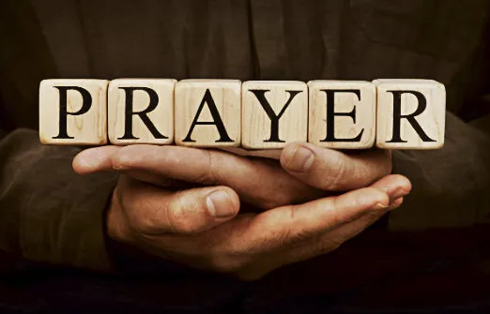

Slide 13
Your Name
CCLI Song # 4611679
Glenn Packiam | Paul Baloche
© 2006 Integrity Worship Music (Admin. by Integrity Music Ltd)
Integrity's Hosanna! Music (Admin. by Integrity Music Ltd)
For use solely with the SongSelect® Terms of Use. All rights reserved. www.ccli.com
CCLI Licence No. 33265

Slide 14
1/4
As morning dawns and evening fades
You inspire songs of praise
That rise from earth to touch Your heart
And glorify Your Name

Slide 15
2/4
Your Name is a strong and mighty tower
Your Name is a shelter like no other
Your Name let the nations sing it louder
'Cause nothing has the power to save
But Your Name

Slide 16
3/4
Jesus in Your Name we pray
Come and fill our hearts today
Lord give us strength to live for You
And glorify Your Name

Slide 17
4/4
Your Name is a strong and mighty tower
Your Name is a shelter like no other
Your Name let the nations sing it louder
'Cause nothing has the power to save
But Your Name

Slide 19
Worthy
CCLI Song # 7111931
Chris Brown | Mack Brock | Steven Furtick
© Music by Elevation Worship Publishing (Admin. by Essential Music Publishing LLC)
For use solely with the SongSelect® Terms of Use. All rights reserved. www.ccli.com
CCLI Licence No. 33265

Slide 20
1/4
It was my cross You bore
So I could live in the freedom You died for
And now my life is Yours
And I will sing of Your goodness forevermore

Slide 21
2/4
Worthy is Your name, Jesus
You deserve the praise
Worthy is Your name
Worthy is Your name, Jesus
You deserve the praise
Worthy is Your name

Slide 22
3/4
And now my shame is gone
I stand amazed in Your love undeniable
Your grace goes on and on
And I will sing of Your goodness forevermore

Slide 23
4/4
Be exalted now in the heavens
As Your glory fills this place
You alone deserve our praise
You're the name above all names

Slide 25
I Speak Jesus
CCLI Song # 7136201
Abby Benton | Carlene Prince | Dustin Smith | Jesse Reeves | Kristen Dutton | Raina Pratt
© 2019 Here Be Lions Publishing (Admin. by Integrity Music Ltd)
Integrity's Praise! Music (Admin. by Integrity Music Ltd)
BEC Worship (Admin. by Song Solutions)
Raina Pratt publishing designee (Admin. by Song Solutions www.songsolutions.org)
WriterWrong Music (Admin. by Song Solutions www.songsolutions.org)
Remaining portion is unaffiliated
For use solely with the SongSelect® Terms of Use. All rights reserved. www.ccli.com
CCLI Licence No. 33265

Slide 26
1/5
I just want to speak the Name of Jesus
Over ev'ry heart and ev'ry mind
'Cause I know there is peace within Your presence
I speak Jesus

Slide 27
2/5
I just want to speak the Name of Jesus
'Til ev'ry dark addiction starts to break
Declaring there is hope and there is freedom
I speak Jesus

Slide 28
3/5
('Cause) Your Name is power
Your Name is healing
Your Name is life
Break ev'ry stronghold
Shine through the shadows
Burn like a fire

Slide 29
4/5
I just want to speak the Name of Jesus
Over fear and all anxiety
To ev'ry soul held captive by depression
I speak Jesus

Slide 30
5/5
Shout Jesus from the mountains
Jesus in the streets
Jesus in the darkness over ev'ry enemy
Jesus for my fam'ly
I speak the holy Name Jesus

Slide 31


Slide 32
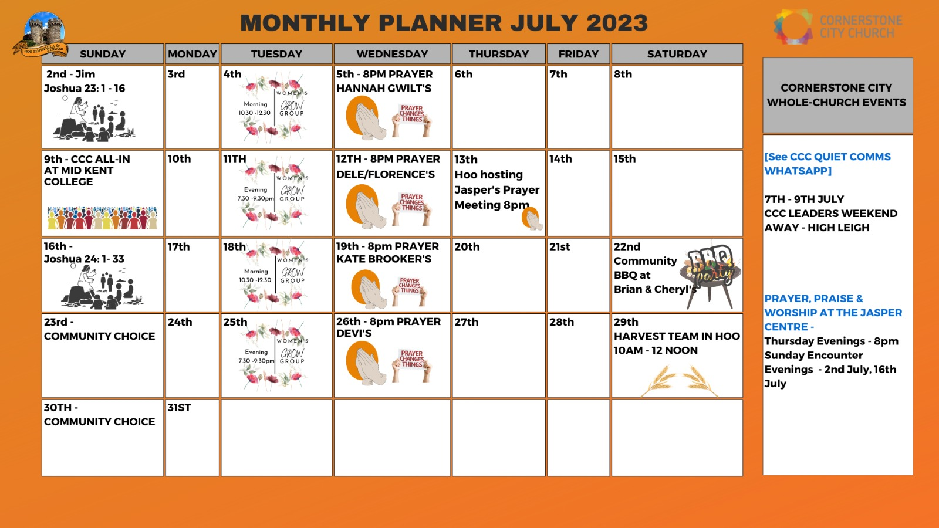

Slide 33


Slide 34
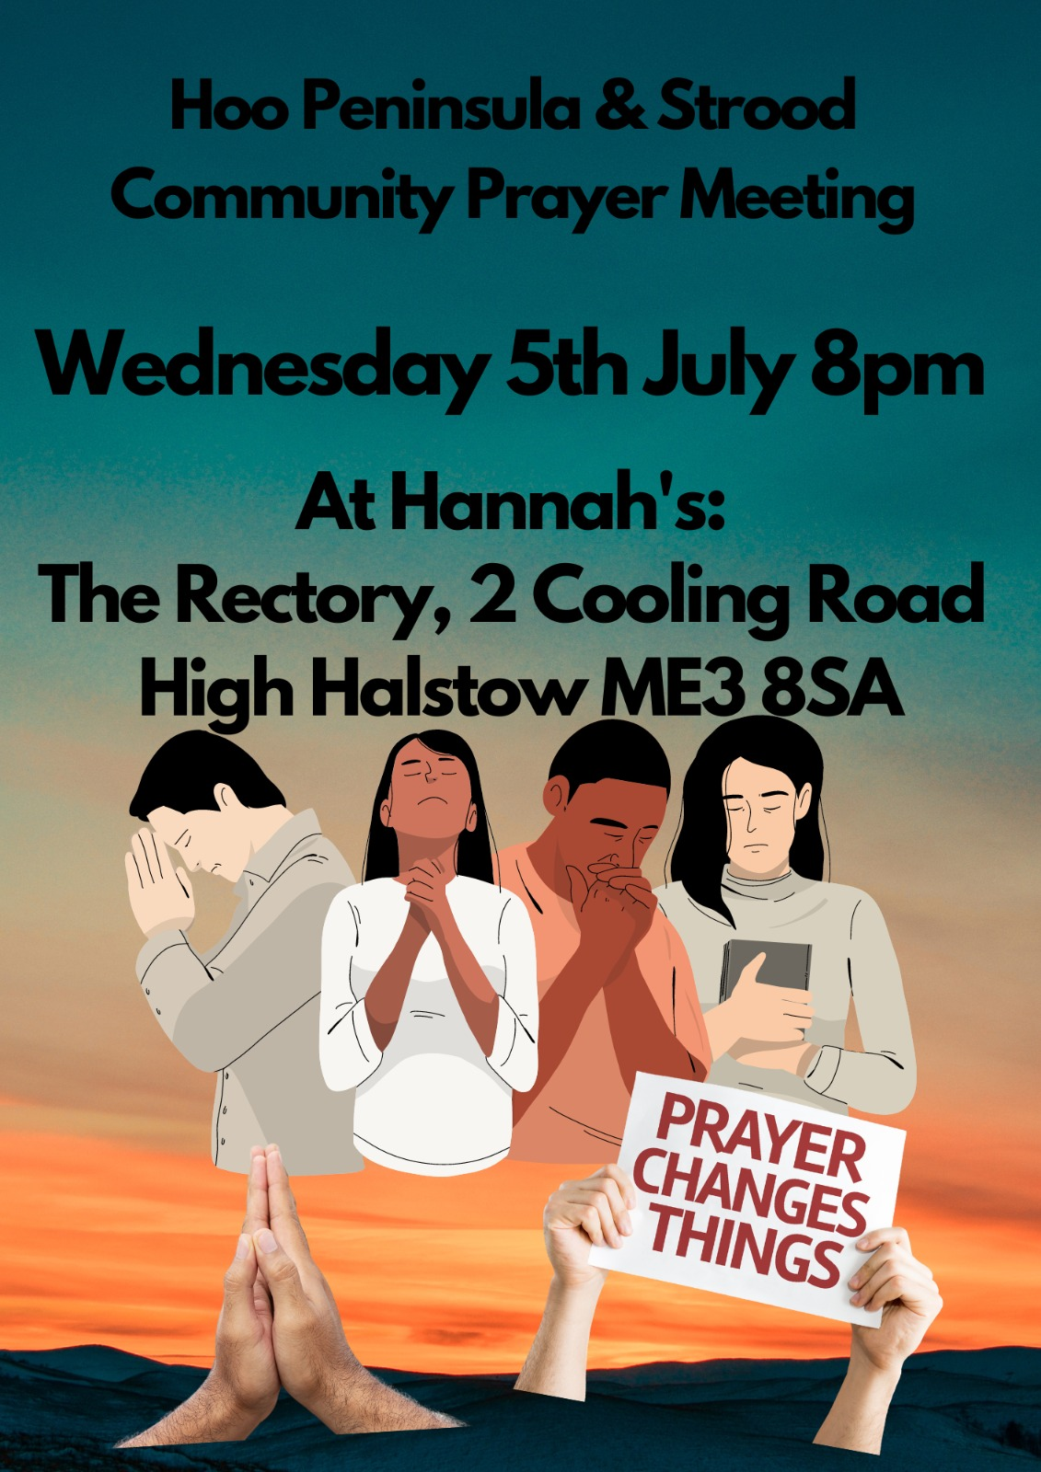

Slide 35


Slide 36
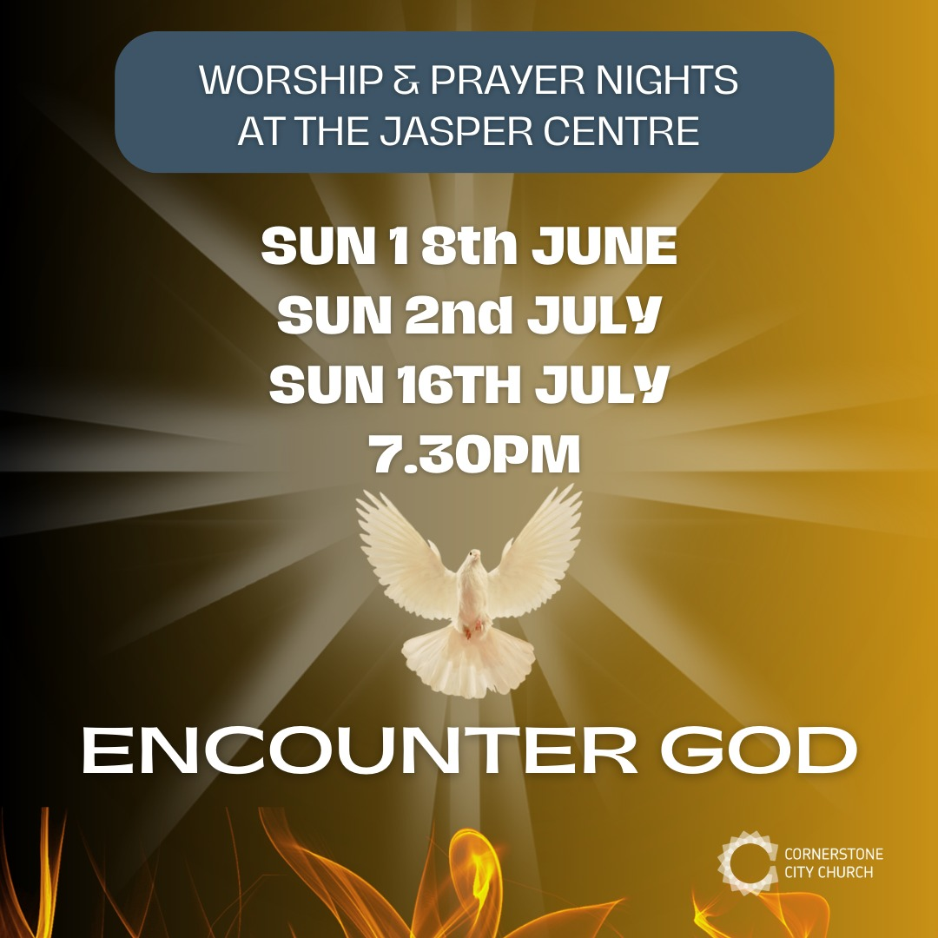

Slide 37


Slide 38
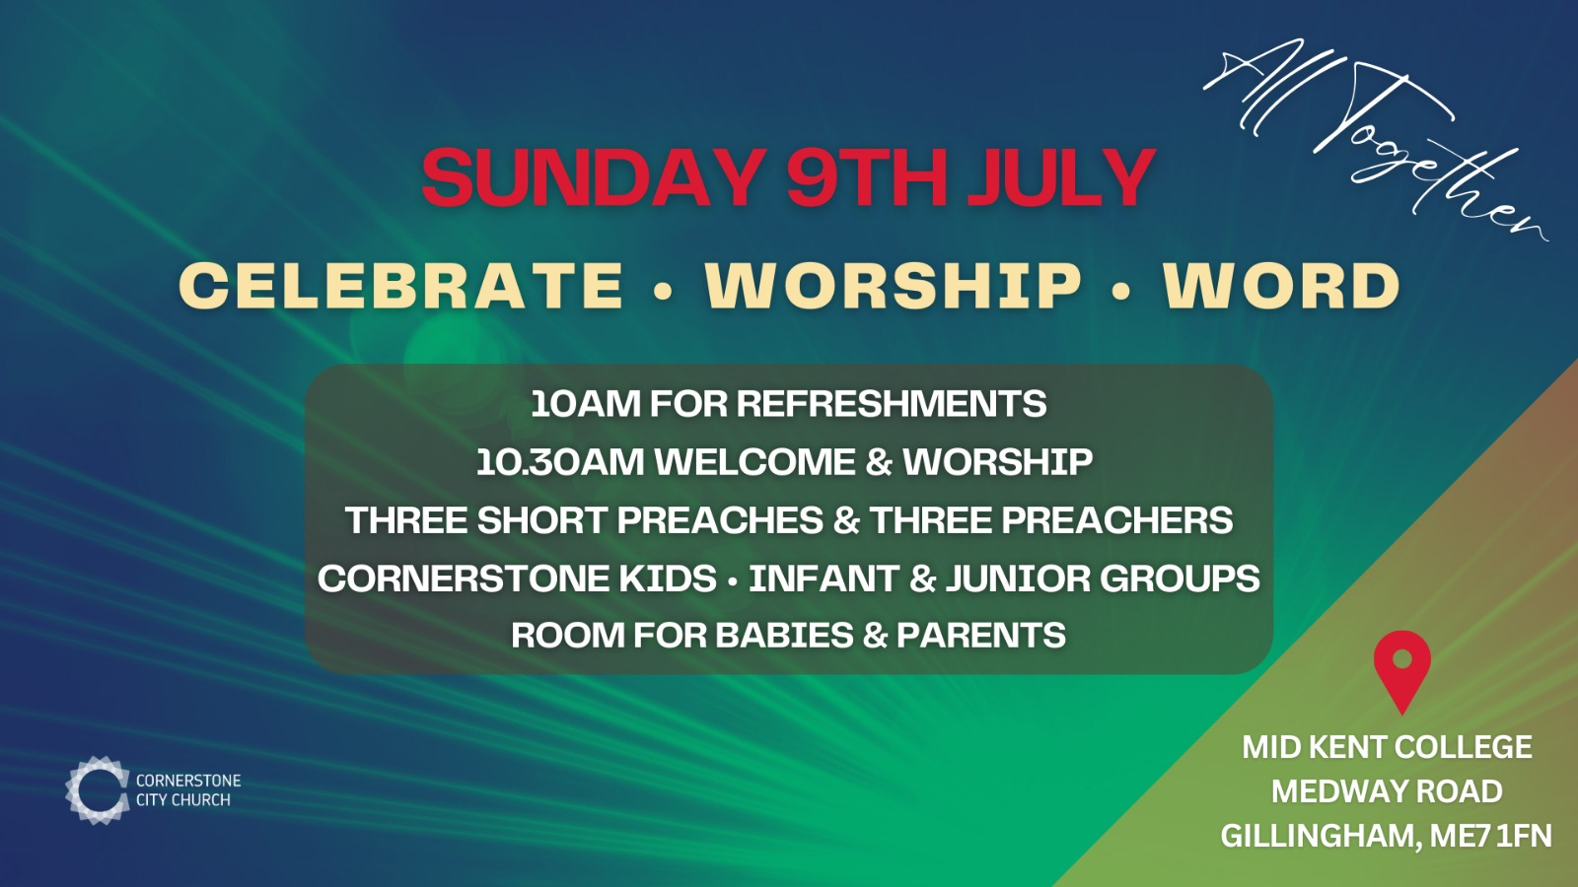

Slide 40
I Lift My Eyes Up
CCLI Song # 317936
Brian Doerksen
© 1990 Mercy / Vineyard Publishing; Vineyard Songs Canada
For use solely with the SongSelect® Terms of Use. All rights reserved. www.ccli.com
CCLI License # 33265

Slide 41
1/2
I lift my eyes up to the mountains
Where does my help come from
My help comes from You
Maker of heaven
Creator of the earth

Slide 42
2/2
Oh how I need You Lord
You are my only hope
You're my only prayer
So I will wait for You
To come and rescue me
Come and give me life

